Slide 1

TEAM- 11

Slide 2
WHY INVENTORY MANAGEMENT?
10%
OF ANNUAL
REVENUE
$200
BILLION
32%
COST REDUCTION
Goes In Inventory Management
Indian E-commerce By 2026
After Implementation Of Artificial Intelligence

Slide 3
HANDLING PRESENT DATA
REDUCING DIMENSIONALITY USING PCA, LDA
HANDLING NOISY DATA BY BINNING, CLUSTERING
DIMENSIONALITY
NOISY DATA
TACKLING MISSING DATA BY IMPUTATION, INTERPOLATION
SKEWED AND BIASED DATA HANDLED USING UPSAMPLING
MISSING DATA
IMBALACED DATA

Slide 4
OUR APPROACH?

Slide 5
5 MODULES OF AI IMPLEMENTATION

Slide 6





THE FIVE MODULES
MODULE 1
MODULE 2
DEMAND FORECASTING AND ORDER MANAGEMENT
WAREHOUSE LOCATION AND SPECIALIZATION
MODULE 3
BEST ROUTE COMPUTATION
MODULE 4
MODULE 5
INVENTORY QUALITY CHECK AND RETURN
INTELLIGENT IoT TRACKING

Slide 7
1. DEMAND FORECASTING AND ORDER MANAGEMENT
DEMAND FORECASTING
OBJECTIVE
Predicting Demand And Optimizing Inventory
Internal Factors, External Factors And Social Media Signals
PROCEDURE
PCA And Time Series Analysis
Prescriptive Analysis Including Stock Out Risk
RESULT
ACCURATE ANALYSIS USING LESS VARIABLES AND
EASY INTEGRATION
30%- 50%
65%
10%- 40%
IMPACT
Error reduction in Supply Chain Network
Reduction in lost sales
Decrease in Warehouse costing

Slide 8
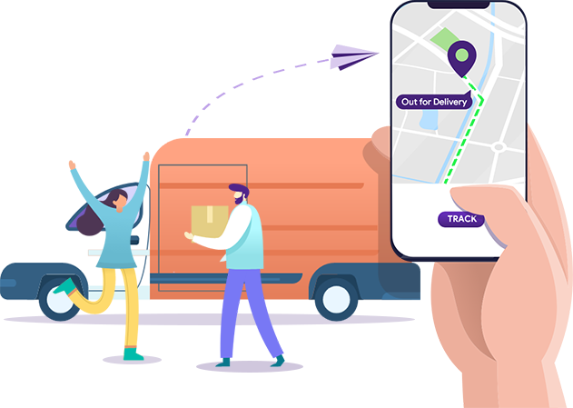
1. DEMAND FORECASTING AND ORDER MANAGEMENT
ORDER MANAGEMENT
1
Orders To Suppliers Through Demand Forecasting
2
Channelizing Dead Stocks Through Discounts And Offers
3
Predicting Buffer Stocks In Shortages
4
Dividing Existing Inventory For Channels Of Sale
Efficiently Tracking Goods And Fulfilling Sales Order

Slide 9
2. WAREHOUSE LOCATION AND SPECIALIZATION
WAREHOUSE SPECIALIZATION
SPECIALIZED WAREHOUSE FOR EACH CATEGORY OF GOODS
Types of Goods
INPUTS LIKE CATEGORY, LOCATION, DEMOGRAPHICS
Essential Goods
Speciality Goods
Shopping Goods
AI PREDICTING WAREHOUSE SPECIALIZATION
High Automation
Prone to
Returns
Special
Handling
FURTHER SORTING DONE ON SIZE OF GOODS

Slide 10
2. WAREHOUSE LOCATION AND SPECIALIZATION
NEXT WAREHOUSE LOCATION?
PROBLEM
VARIABLES
RESULT
Costly
Irreversible
Management Intensive
Demographic
Geographical
Infrastructural
Competition
Optimum Location With Regression And Classification Models

Slide 11
3. BEST ROUTE COMPUTATION
THE IMPACT
03
REDUCE WAREHOUSING COST DRASTICALLY BY DECREASING THE NUMBER OF STOPS DURING TRANSIT.
THE ISSUE
01
02
WAREHOUSE CONSTRUCTION IS COSTLY
INVENTORY HOLDING CAUSES CAPITAL DRAINS
A SOLUTION
SELECTING BEST ROUTE OF TRANSIT
AUTOMATING DECISION MAKING WITH ROBUST AI MODELS
JUST-IN-TIME PRINCIPLE

Slide 12
3. BEST ROUTE COMPUTATION
HOW IT WORKS?
CUSTOMER PLACES ORDER
SELECT BEST ROUTE
Placed Orders Goes To Order Management System
Stock Availability, Route Performance, Time Delay
Sellers, Distributors And Manufacturers
Product Shipped and Customer Updated With Arrival Time
AI CHECKS MULTIPLE ROUTES
SHIPMENT

Slide 13

4. INVENTORY QUALITY CHECK AND RETURNS
QUALITY CHECK
OBJECTIVE
GOALS
Developing Warehouse Performance Index (WPI)
Training workforce efficiently
Assist Audit firms in inspection
INPUT
PROCESSING
OUTPUT
X = Returns/ Shipping
Y = Items Missing
Threshold Of WPI
User & Workers Feedback
Classification Models And Outlier Detection
Analysis To Calculate Threshold For WPI
WPI Calculation Using AI And Suggested Solutions

Slide 14
4. INVENTORY QUALITY CHECK AND RETURNS
OPTIMIZING RETURNS
GOALS
ASSUMPTIONS
67%
Minimise Time
Fraud Detection
Optimize Customer Experience
Organization Should Have Offline Accessible Return Points
People Prefer Offline Returns
INPUT
PROCESSING
OUTPUT
Best Route To Return From Customer Inputs.
Fraud Detection Using Image Processing
Initiating And Automating Refund Or Exchange
Seamless Customer Experience, Suggested Offline Return Centers And Reduced Loss Of Company
Customer Location
Product To Return
Exchange Or Refund

Slide 15

5. INTELLIGENT IOT TRACKING
ABOUT BLE TAGS
What is it?
Scalable beacon based asset tracking system
What it does?
Provide periodic GPS, temperature data
What it costs?
Cost To Buy BLE Tags
+
Cost Of IoT Platform
Where to use?
Warehouse & Freight Containers Clubbed with QR and barcodes
100%- 300%
50%- 80%
12%- 22%
Increase In Range
Decrease In Costs
Increase In Tracking Accuracy

Slide 16
WHAT ARE WE DOING?
Listing Variables Considered
Decreasing Computation Cost
1
2
3
4
5
Stating The Scope Clearly
Improving The Current Data
Interconnecting Modules

Slide 17
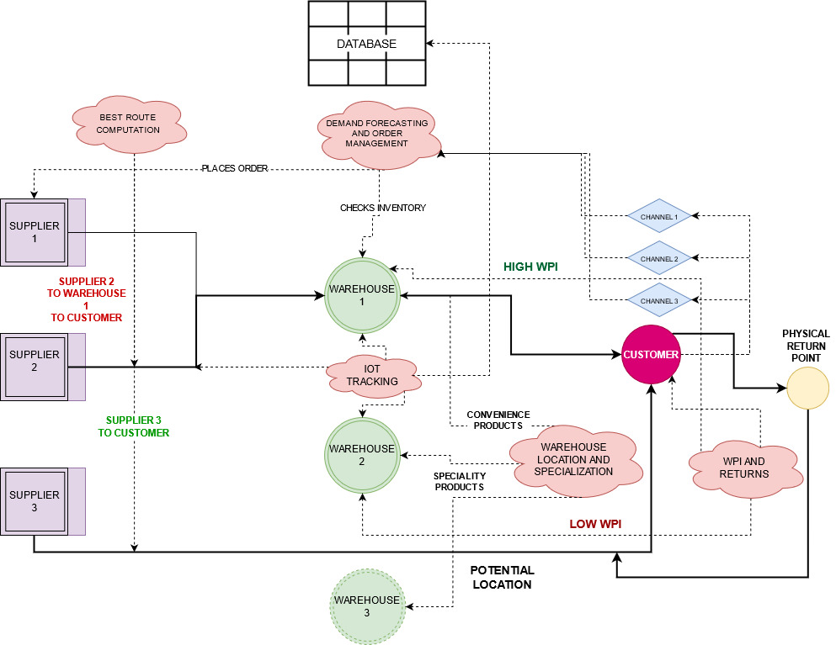
OUR SOLUTION IN APPLICATION

Slide 18
HOW OUR SOLUTION IS USEFUL?
Managing Loopholes
Reducing Error In Forecasting
Increasing Speed And Agility
Integrating With Current System
Identify Risk And Reduce Disruption
Upgrading And Re-design Inventory

Slide 19
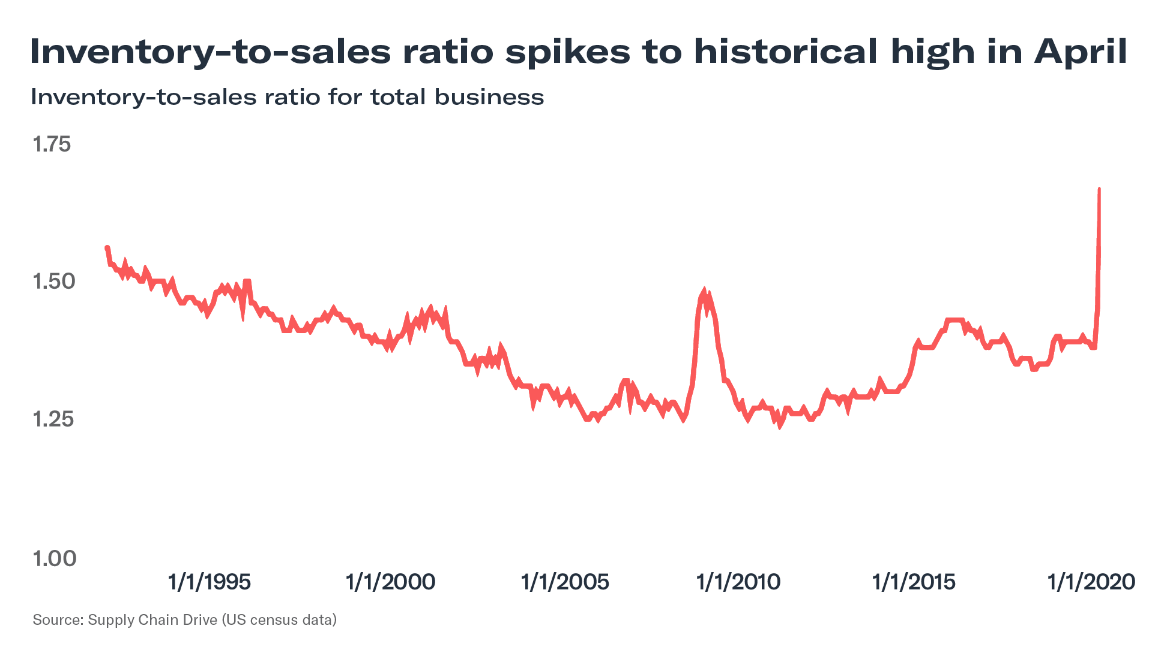
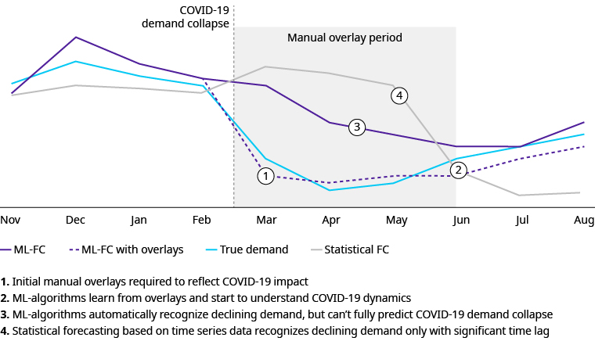
COVID-19 IMPACT AND SOLUTIONS
Machine Learning Forecasting Platform
Covid-19 Overlays
New Inventory Levels
Order Book Realignment
Track And
Trace

Slide 20
REFERENCES
The Ultimate Guide to Sales Forecasting written by Aja Frost
Using Machine Learning and Predictive Analytics to See the Future of Sales by Altexsoft r&d engineering
The New Omnichannel Imperative: AI to the Rescue by Vikram Murthi
Inventory Space Management - Warehouse Design: What are the key factors to consider? By Logistics Bureau
Warehouse design and layout: 6 basic factors by Mecalux
Warehouse Design, Layout and Location: A Detailed Guide by Orderhive.
Selection of warehouse location for a global supply chain: A case study by Rajesh Kr Singh
Research paper on IoT asset tracking
Comparing RFID and BLE
Covid Impact on supply chain of E-commerce
ML forecasting and covid overlays

Slide 21
THANK YOU

